Slide 1
Covid in Chicago
Exploring Data

Slide 2
When the pandemic first started (March-April 2020), what new things did you start doing with all of your extra time?
Notes:
“How did your daily life change at the very beginning of the Covid pandemic in March-April of 2020?”

Slide 3
On your each of your post-its, write down one thing that was known and one thing that was not known about Covid in the early days of the pandemic with respect to the disease itself (origins, how it spread, symptoms, who it affected more, etc.)

Slide 4
Notebook 7 (Part 1) Tasks
Normalize the number of deaths in Chicago by creating a new column: “DeathsPer1000”
Create a line graph with title and labeled axes showing the change in death rates between 2012 and 2021.

Slide 5
How can we best measure Covid’s impact on different communities in Chicago?

Slide 6

Our data…
In May 2020, Kevin Credit from the Center for Spatial Data Science at the UChicago wrote "Neighborhood inequity: Exploring the factors underlying racial and ethnic disparities in COVID-19 testing and infection rates using ZIP code data in Chicago and New York".
Kevin's research also would not have been possible without open source research data from: Illinois Department of Health: https://www.dph.illinois.gov/covid19/covid19-statistics
U.S. Census Bureau: https://data.census.gov/cedsci
Notes:
https://rsaiconnect.onlinelibrary.wiley.com/doi/abs/10.1111/rsp3.12321

Slide 7
Notebook 7 (Part 2) Tasks
Explore the available variables and their values
Identify variables that could be used to measure Covid’s impact.
Notes:
“What variables in the dataset could be used to measure Covid’s impact?” Students may notice that the dataset does not provide number of deaths, therefore mortality cannot be used as our outcome variable. Allow this conversation to identify the most viable options: cases and tests.

Slide 8
What variables in the dataset could be used to measure Covid’s impact?

Slide 9

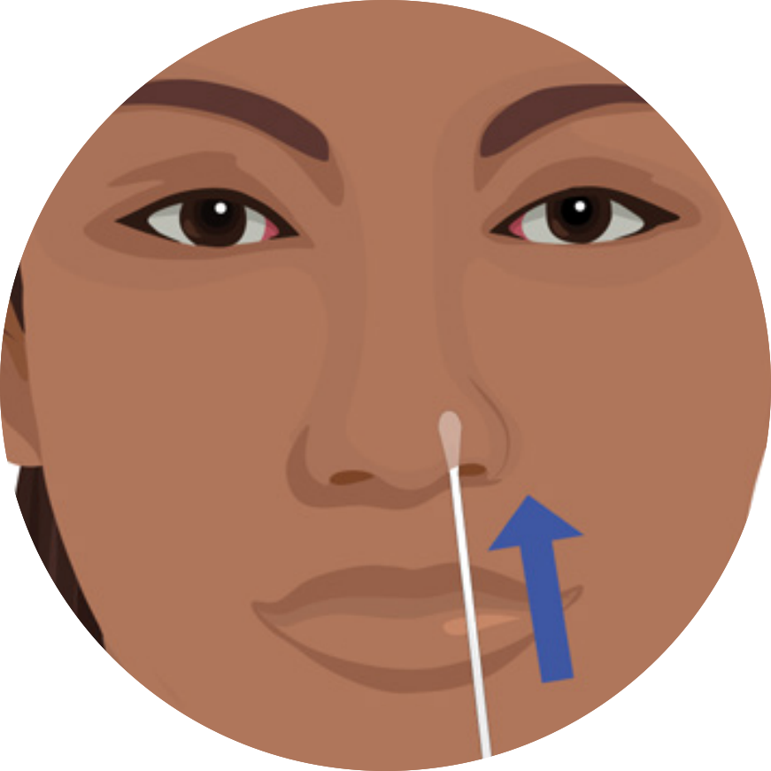
Which variable is better to describe Covid’s impact?
Cases: The number of people that tested positive
Tests: The number of people that were tested
Notes:
list the advantages and disadvantages of each. In order to get ideas flowing ask them: What has to happen for a person to get recorded in this data? Lead them in this manner: for someone to be listed as a case, they have to be tested, for someone to be tested, they have to have a reason (symptoms, exposure, etc.).

Slide 10
Notebook 7 (Part 3) Tasks
Generate a new column of data for the week of 4/16 called “case_rate_4_16” using the “case_rate” function.
Make a function called “test_rate” that normalizes test rate
Generate a new column of data for the week of 4/16 called “test_rate_4_16” using the “test_rate” function.

Slide 11
Which variable is better to describe Covid’s impact?
Let's say there is a building containing 10 people.
Let's say 5 out of the 10 people have COVID.
But only 2 out of the 10 people get tested -- 1 comes back positive, 1 comes back negative.
Therefore:
case_rate = 1/10 = 10%
testing_rate = 2/10 = 20%

Slide 12
Reducing the effect of testing…
X 100% = Positivity rate
Notes:
“How does positivity rate correct for differences in testing?”

Slide 13
In areas with low testing…
X 100% = Positivity rate
Notes:
even if a community has a low testing rate (Slide 12), positivity rate will still be high if there are a lot of infections

Slide 14
In areas with high testing…
X 100% = Positivity rate
Notes:
If an area has a high testing rate (Slide 13), more people will test positive, but it will be balanced out by the larger number of tests.

Slide 15
Notebook 7 (Part 4) Tasks
Define a function called positivity_rate that calculates positivity rate
Create a new column in the dataframe for the week of 4/16 called “pos_rate_4_16” and view the new data

Slide 16
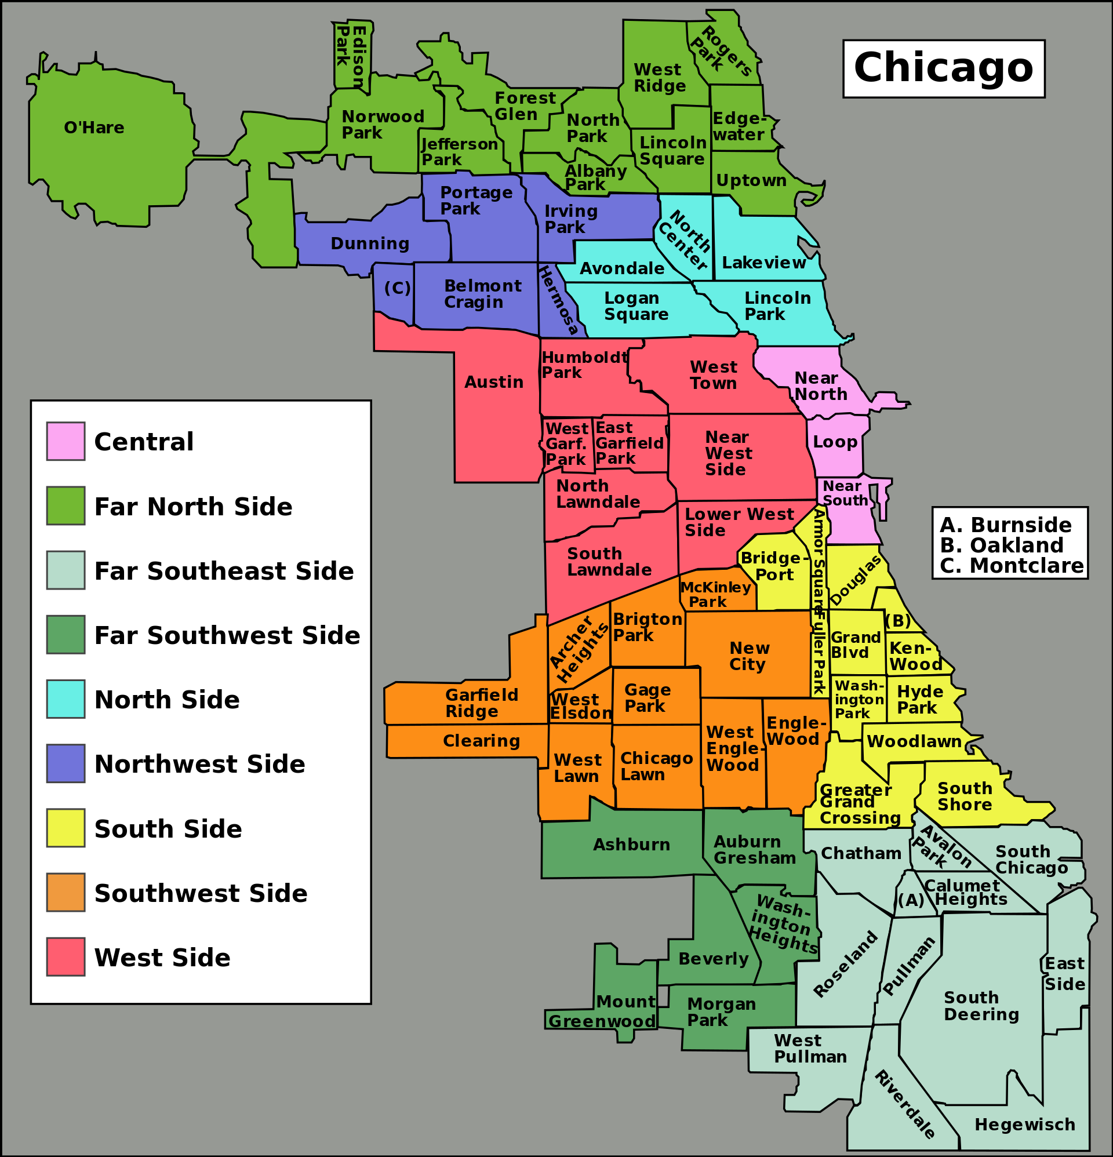

Which “sides” of Chicago do you think have been impacted most by Covid? Why?”

Slide 17
Exploring Covid with Kepler
Go to kepler.gl on your browser
Download the Covid dataset from Google Drive
cov_chi_with_positivity.geojson
Expand the layer with the “˅” button
Click the three vertical dots next to “Fill Color”
Change “Color Based On” to pos_rate_4_16
Click on the color scale and check the “Reversed” toggle
Notes:
do an Exploratory Spatial Data Analysis of this question

Slide 18
“Why has Covid affected some communities more than others?”

Slide 19




How can a community and its people be described with data?
Notes:
Characteristics of a good question. What was our question in the cholera case?

Slide 20
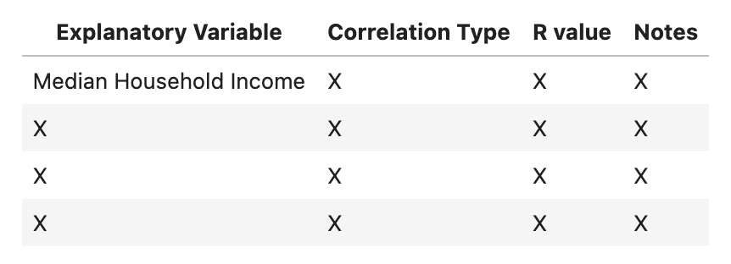
Notebook 8 Task
Explore a total of 4 explanatory variables. Record what you learn from each in the following table:

